Slide 1
Predictive Data Mining on Covid-19 Dataset
Predictive Data Mining
Created by: Chaitanya Yadavally, Sravanthi Shyamreddy, Rishika Devaragatla, Yamini Chitikela, Saidi Reddy Chennu

Slide 2
4
1
Comparisons
Dataset Description
2
5
Data Mining Techniques Performed
Overview
Classification Tool
3
6
Implementation and Conclusion
References

Slide 3
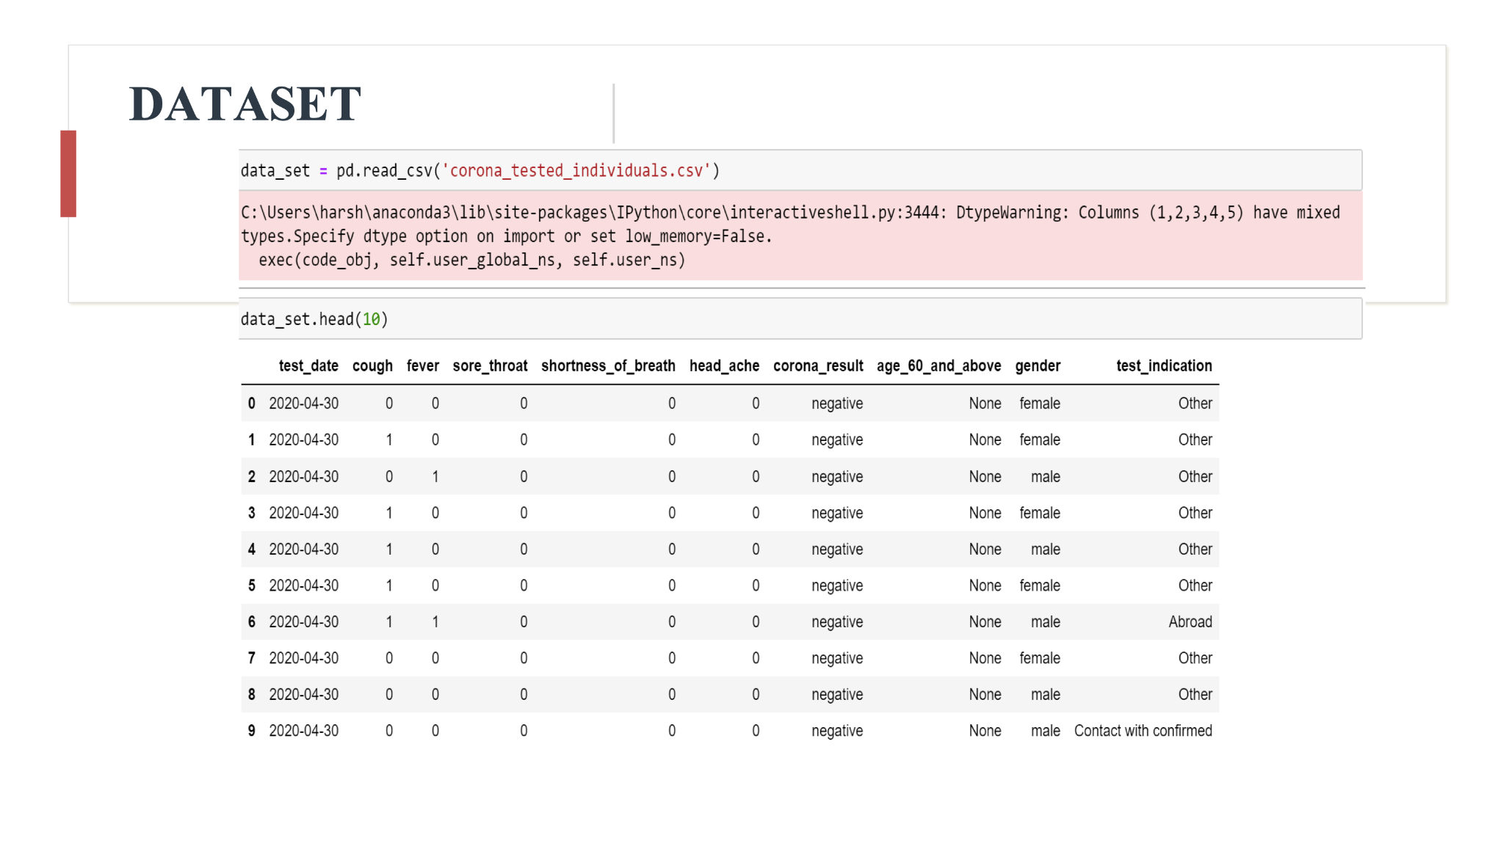

Slide 4
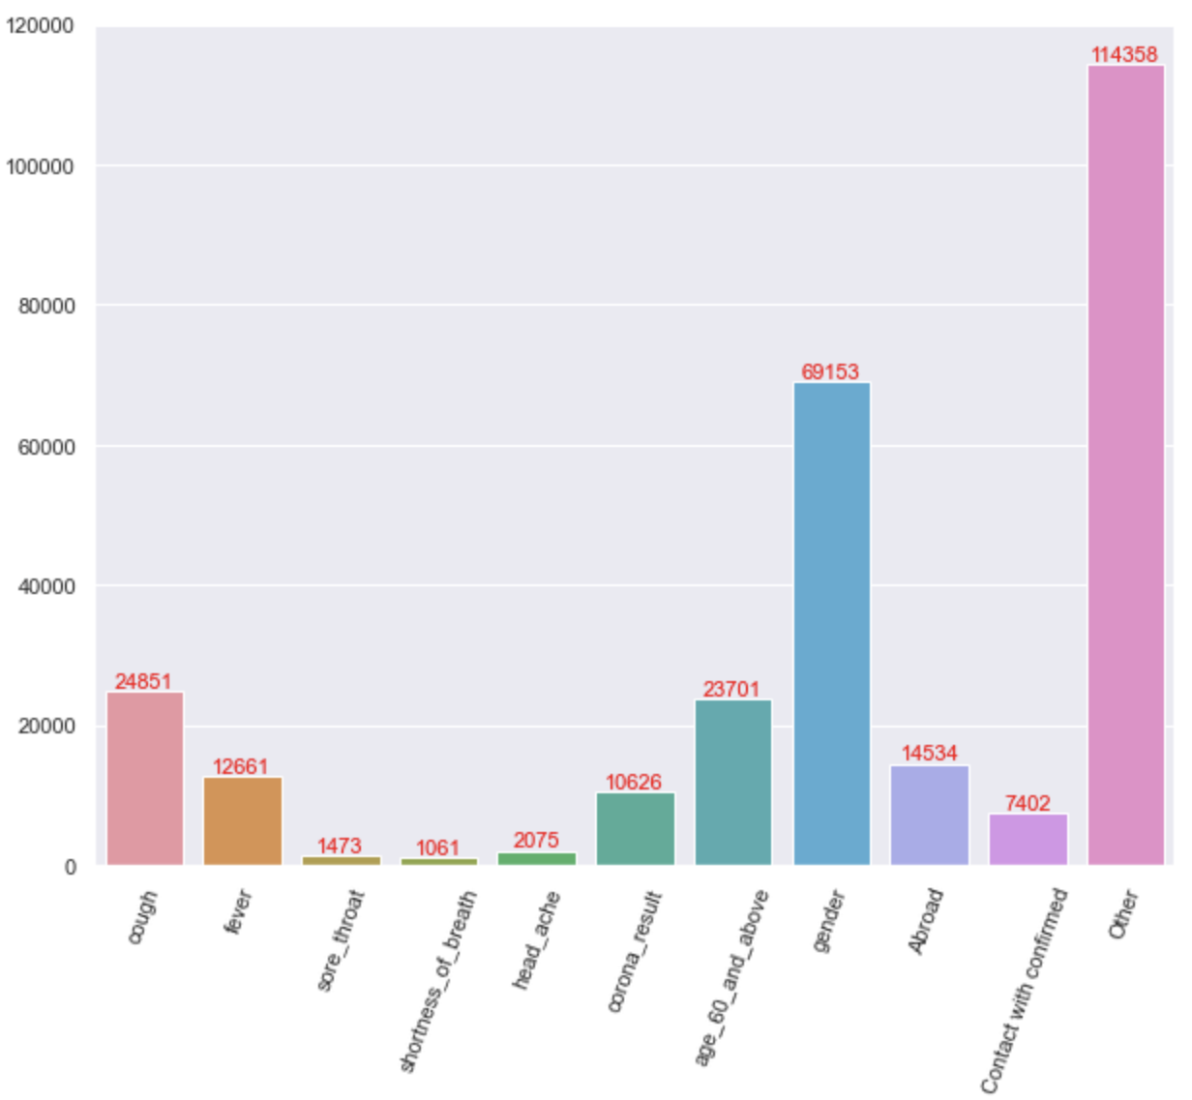
Classification of DataSet
Test_date
Gender
Test Indication
Corona Result
This information gives us about when the test is done and result is noted down
This characteristics identifies whether the patient is male or female
This trait indicates whether or not a person has
covid 19
This feature says whether the covid-19 is transferred via abroad or confirmed with contact or some other reason
Shortness of breath
Headache
Fever
It tells whether or not the patient has a temperature
It reveals whether or not the patient is experiencing shortness of breath
It indicates that whether or not the patient is suffering from headache or not
Age 60 and above
Cough
Sore throat
It reveals that whether or not the patient has a cough
It reveals whether or not the patient is experiencing sore throat
It indicates whether the person is over 60

Slide 5
Dataset Goals
The ultimate goal is to create a model that forecasts COVID-19 using the best predictive data mining technique.
Also Our objective is to provide reliable prediction with fewer parameters and tests.
There were four different classification methods used. Support vector machines, K nearest neighbors, logistic regression, and decision trees are a few of the techniques used.
The data was pre-processed before being utilized in the model. The methods that perform well in this paradigm include the support vector machine and decision trees.
However, given their lower time complexity, decision trees were investigated. Other approaches, like as clustering, association rules, and genetic algorithms, might be used to broaden this.
Decision Tree
KNN
Logical Regression
SVM

Slide 6
Predictive Data Mining Techniques Performed
KNN
Decision Tree
K-Nearest Neighbors is performed based in “how similar” the data or a vector from other.
01
02
This is process performed to find the configuration of hyperparameters that results in best performance
Support Vector Classifier
Logistic Regression
03
04
Support vector classifier is used for both classification and regression., which in sense measure the similarity between observations.
Logistic Regression is performed on the dataset to predict the numeric values in a given dataset.

Slide 7
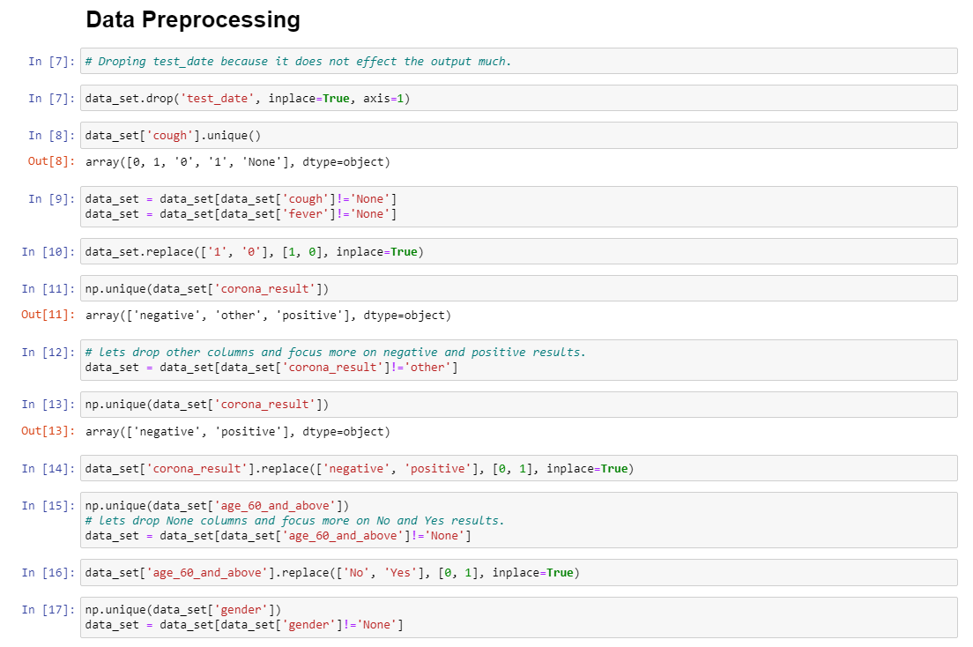
Data Preprocessing

Slide 8
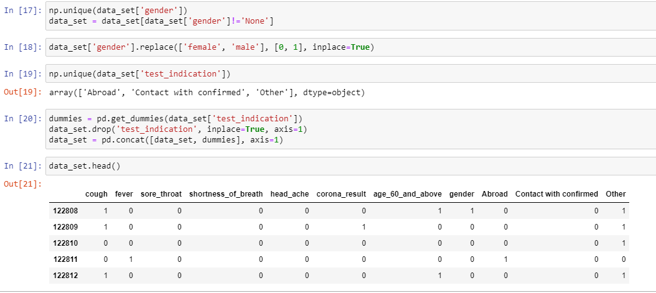
Data Preprocessing

Slide 9
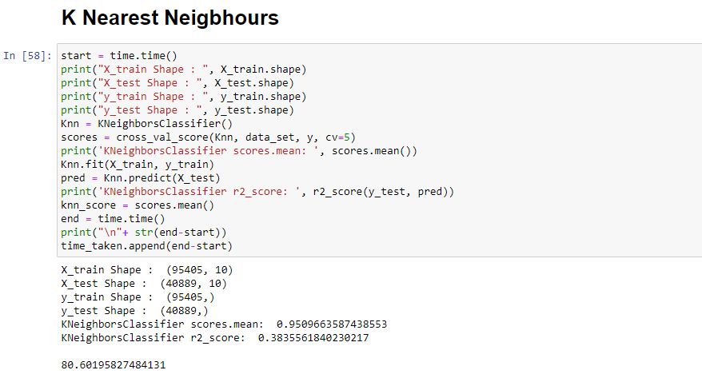
KNN
Implementation
Interpreted Results
Correctly classified instances – 95.09%
Incorrectly classified instances – 4.91%
R2 score – 0.383
Time taken – 80.601s

Slide 10
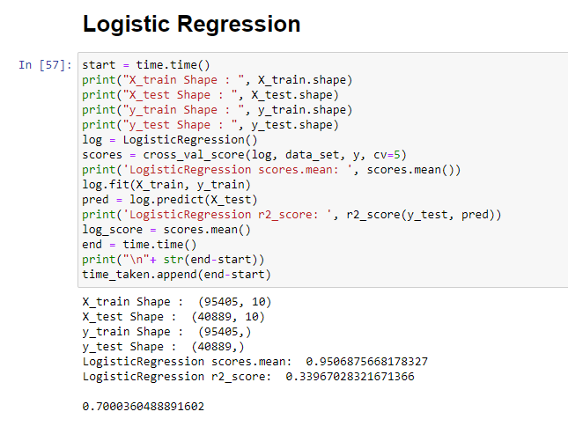
Logistic Regression
Implementation
Interpreted Results
Correctly classified instances – 95.06%
Incorrectly classified instances – 4.94%
R2 score – 0.33
Time taken – 7.75s

Slide 11
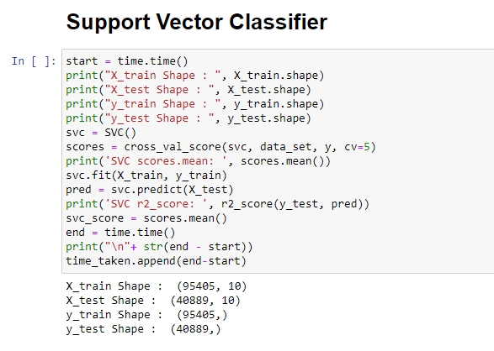
Support Vector Classifier
Implementation
Interpreted Results
Correctly classified instances – 95.80%
Incorrectly classified instances – 4.20%
R2 score – 0.41
Time taken – 479s

Slide 12
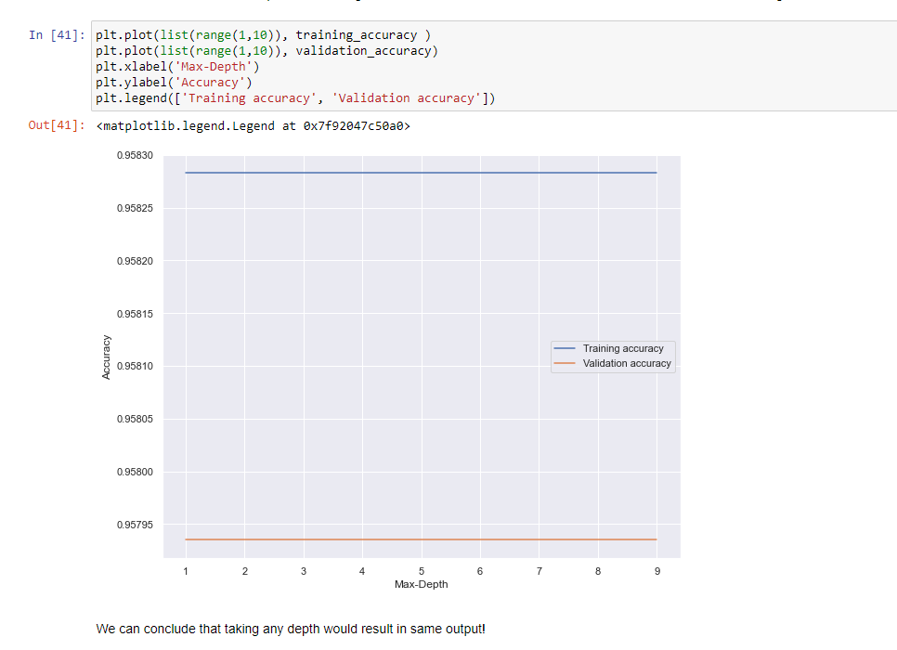
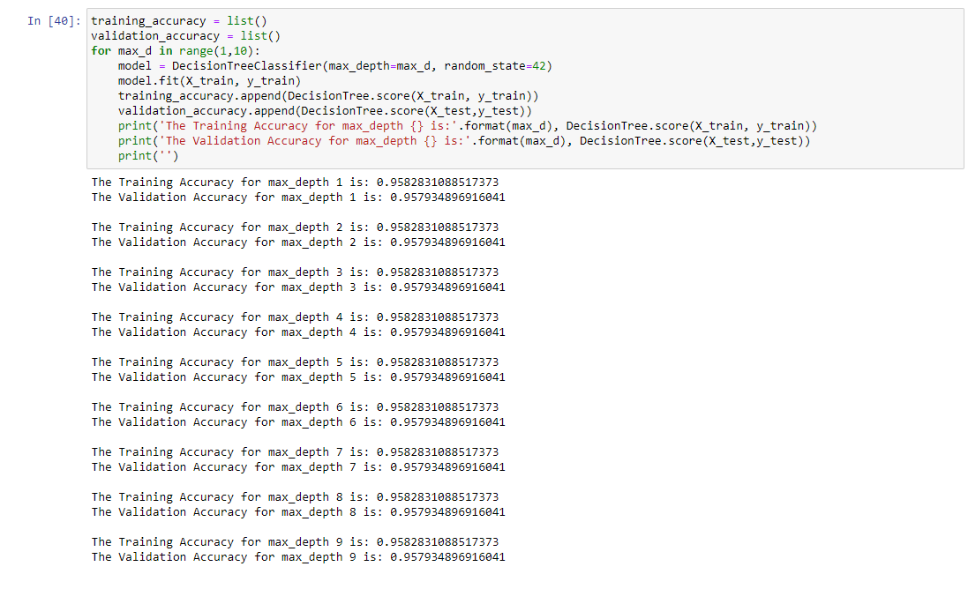
Hyper-parameter tunning
Implementation
Interpreted Results

Slide 13
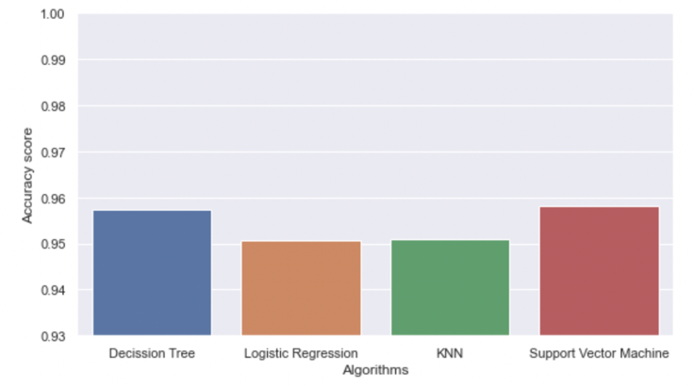
Algorithms vs Accuracy Scores

Slide 14
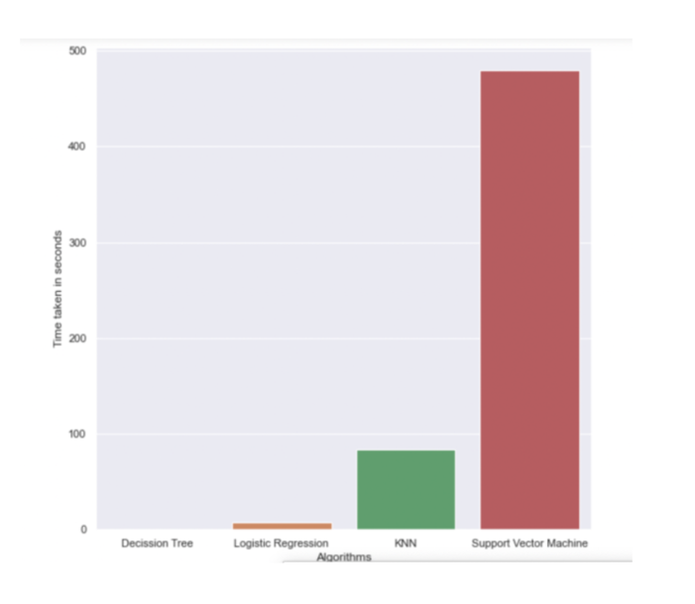
Algorithms vs Time Complexity

Slide 15
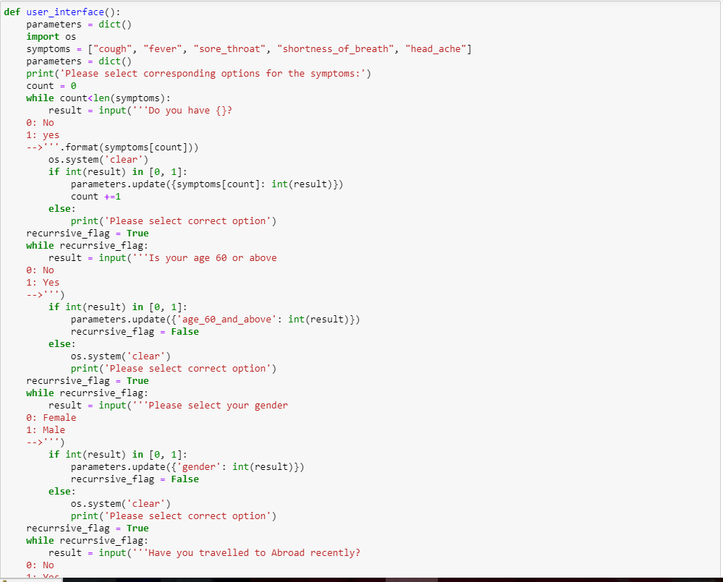
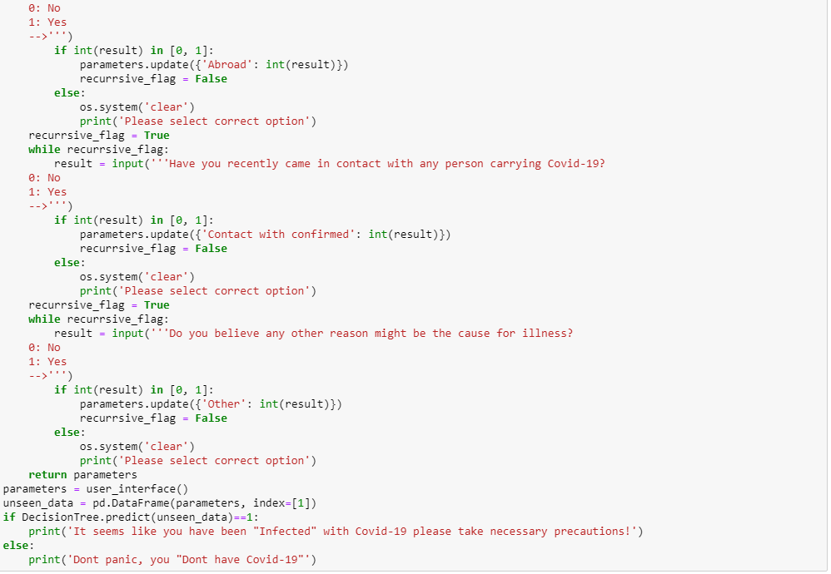
Mini Classification Tool Code

Slide 16
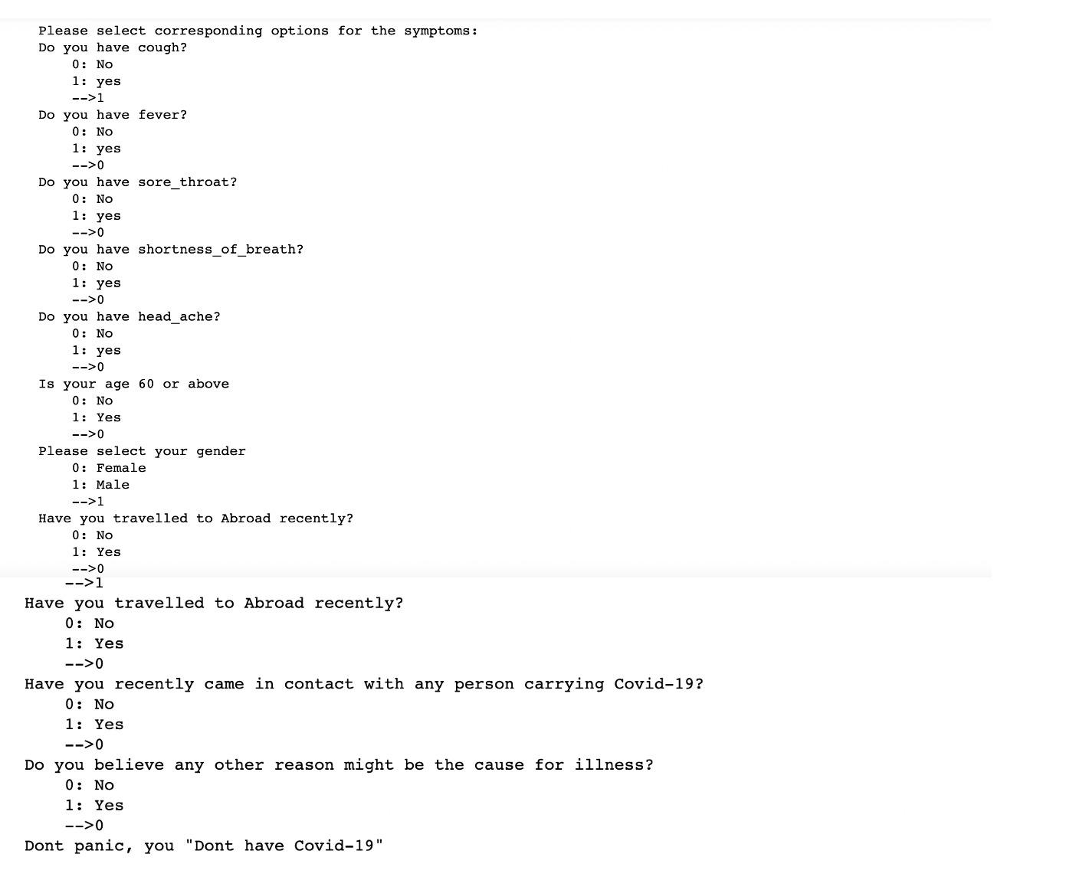
Mini Classification Tool
Input/Output 1

Slide 17
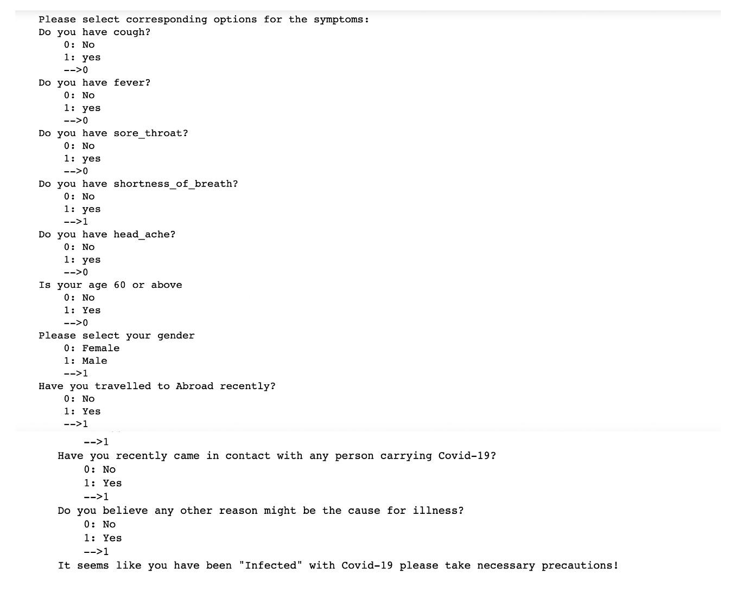
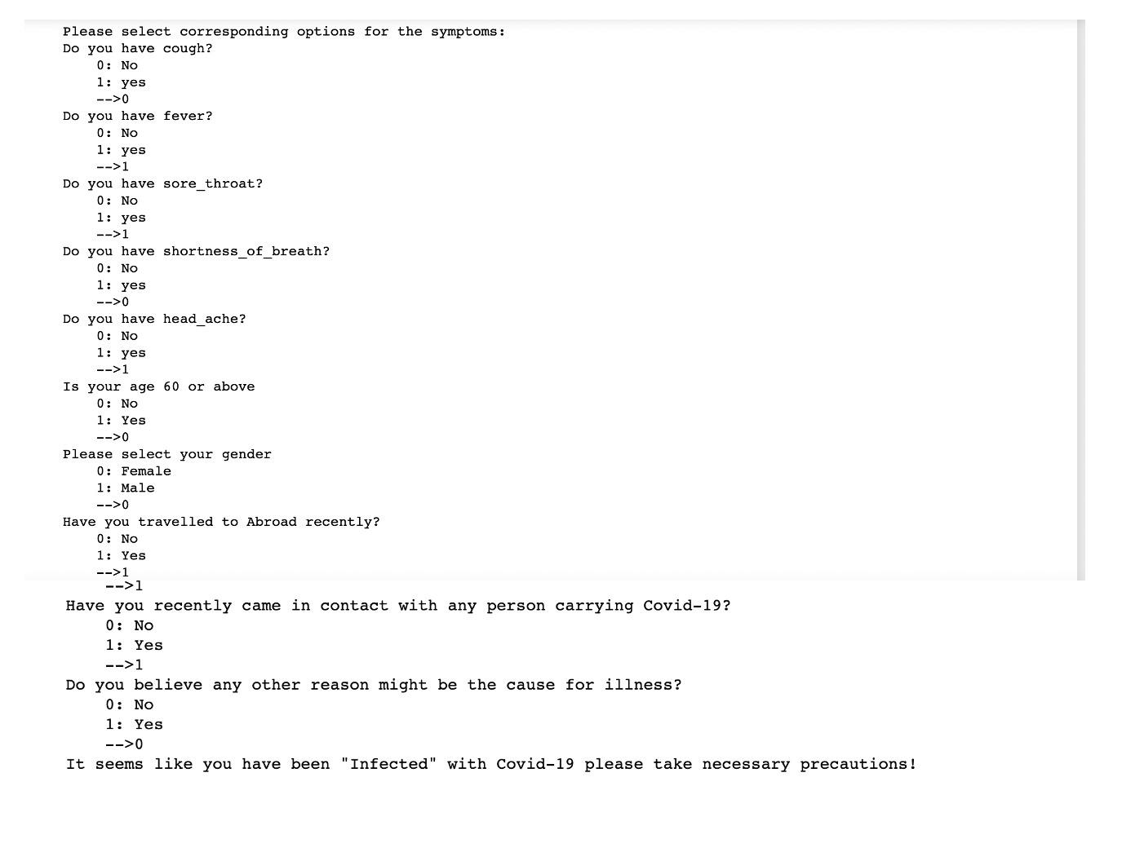
Input/Output 2
Input/Output 3
Using different inputs to check the predictions done by the classification tool.

Slide 18
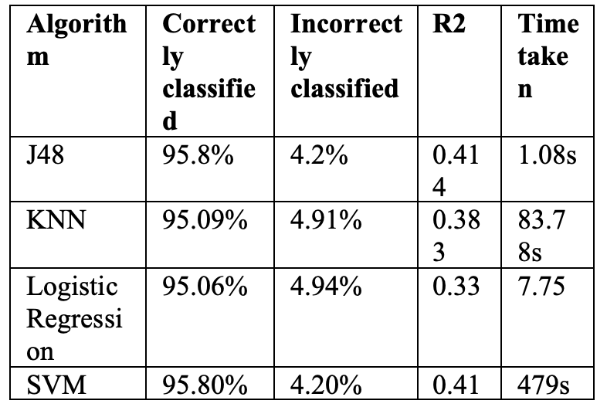
Conclusion
The support vector machine and decision trees are the strategies that give the best results in this paradigm. However, Decision trees were explored since they have a reduced time complexity
To widen this, other methodologies like clustering, association rules, and genetic algorithms might be applied.

Slide 19
References
https://www.kaggle.com/datasets/imdevskp/corona-virus-report
https://scikit-learn.org/stable/auto_examples/ensemble/plot_forest_importances.html
https://jupyter.org/
https://pandas.pydata.org/
https://numpy.org/
https://scikit-learn.org/stable/modules/tree.html
https://scikit-learn.org/stable/modules/svm.html
https://scikit-learn.org/stable/modules/generated/sklearn.linear_model.LogisticRegression.html

